Slide 1
Solving and Analyzing Side-Chain Positioning Problems Using Linear and Integer Programming
Carleton L. Kingsford, Bernard Chazelle and Mona Singh
Bioinformatics Vol. 21, no. 7, pages 1028–1036, 2005
Date: October 6, 2005
Created by Jing-Liang Hsin

Slide 2
Abstract
Side-chain positioning is a central component of homology modeling
and protein design. In a common formulation of the problem, the
backbone is fixed, side-chain conformations come from a rotamer library,
and a pairwise energy function is optimized. It is NP-complete to find
even a reasonable approximate solution to this problem. We seek to put
this hardness result into practical context.
We present an integer linear programming (ILP) formulation of side-
chain positioning that allows us to tackle large problem sizes. We relax
the integrality constraint to give a polynomial-time linear programming
(LP) heuristic. We apply LP to position side chains on native and
homologous backbones and to choose side chains for protein design.

Slide 3
Abstract
Surprisingly, when positioning side chains on native and homologous
backbones, optimal solutions using a simple, biologically relevant energy
function can usually be found using LP. On the other hand, the design
problem often cannot be solved using LP directly; however, optimal
solutions for large instances can still be found using the computationally
more expensive ILP procedure. While different energy functions also
affect the difficulty of the problem, the LP/ILP approach is able to find
optimal solutions. Our analysis is the first large-scale demonstration that
LP-based approaches are highly effective in finding optimal (and
successive near-optimal) solutions for the side-chain positioning problem.

Slide 4
Problem Formulation
The potential energyε = E₀ + Σ_{i} E( i_{r} ) + Σ_{i<j} E( i_{r} , j_{s} )
  E₀ is the self-energyof the backbone.
  E( i_{r} ) is the energy resulting from the interaction between the backbone and the chosen rotamer i_{r} at position i as well as the intrinsic energy of rotamer i_{r} .
  E( i_{r} , j_{s} ) accounts for the pairwise interaction energy between chosen rotamers i_{r} and j_{s} .

Slide 5
Problem Formulation
Reformulate the SCP problem in graph-theoretic terms
  Let G be an undirected p-partite graph.
  The node set V₁ ∪· · ·∪ V_{p} , where V_{i} includes a node u for each rotamer i_{r} at position i.
  Each node u of V_{i} is assigned a weight E_{uu} = E( i_{r} ) .
  Each pair of nodes u ∈ V_{i} and v ∈ V_{j} (i = j ), corresponding to rotamers i_{r} and j_{s} respectively, is joined by an edge with a weight of E_{uv} = E( i_{r} , j_{s} ).

Slide 6
Integer Linear Programming Formulation
The vertex set of this graph is V = V₁ ∪· · ·∪ V_{p}, and its edge set D = {(u, v) : u ∈ V_{i} , v ∈ V_{j} , i = j }.
We introduce a {0, 1} decision variable x_{uu} for each node u in V , and a {0, 1} decision variable x_{uv} for each edge in D.
The following integer program ensures these conditions:
  Minimize ε = Σ_{u∈V} E_{uu} x_{uu} + Σ_{{u,v}∈D} E_{uv} x_{uv}
  subject to
Σ_{u∈ Vj} x_{uu} = 1 for j = 1, . . . , p
Σ_{u∈ Vj} x_{uv} = x_{vv} for j = 1, . . . , p and v ∈ V \ V_{j}
x_{uu}, x_{uv} ∈ {0, 1}

Slide 7
Integer Linear Programming Formulation
For each V_{j} , let N⁺(V_{j} ) be the set union of the V_{i} for which there exists some v ∈ V_{i} and u ∈ V_{j} with E_{uv} > 0.
Let D’ be the set of pairs {u, v} with u ∈ V_{j} such that either v ∈ N⁺(V_{j} ), or v ∈ N⁺(V_{j} ) but E_{uv} < 0.
The modified ILP is as follows:
  Minimize ε = Σ_{u∈V} E_{uu} x_{uu} + Σ_{{u,v}∈D’} E_{uv} x_{uv}
  subject to
Σ_{u∈ Vj} x_{uu} = 1 for j = 1, . . . , p
Σ_{u∈ Vj} x_{uv} = x_{vv} for j = 1, . . . , p and v ∈ N⁺(V_{j} )
Σ_{u∈ Vj},_{Euv < 0} x_{uv} ≤ x_{vv} for j = 1, . . . , p and v ∈ N⁺(V_{j} )
x_{uu}, x_{uv} ∈ {0, 1}

Slide 8
LP/ILP Approach
We solve the problem of interest using the computationally easier LP formulation. If the solution returned is integral, then the problem instance was easy to solve, and we have the optimal solution to the original SCP problem.
Otherwise, we run polynomial-time Goldstein dead-end elimination (DEE) (Goldstein, 1994) until no more rotamers can be eliminated and then solve the more difficult ILP.
The CPLEX package with AMPL (Fourer et al., 2002) was used to solve the linear and integer programs.

Slide 9
Rotamer Library
Using Dunbrack’s backbone-dependent rotamer library (Dunbrack and Karplus, 1993).
For each 10◦ range ofψ(phi), φ(psi) backbone angles, this library has 320 rotamers.

Slide 10
Dead-End Elimination
In the cases where ILP was necessary, we first processed the problem instances with DEE.
A rotamer u ∈ V_{i} can be thrown out if there is some other rotamer v ∈ V_{i} such that
E_{uu} − E_{vv} + Σ_{j =i} min _{w∈Vj} (E_{uw} − E_{vw}) > 0.

Slide 11
Energy Function
Van der Waals interactions between rotamers
  The pairwise van der Waals interaction energy between rotamers u and v is the sum of the van der Waals interactions between the side-chain atoms of u and v.
  The parameters used in the van derWaals force are those of AMBER96.
Van der Waals interactions in self-energy terms

Slide 12
Energy Function
Statistical self-energies
  For each amino acid i in a particular backbone setting, let p_{iu} be the fraction of times amino acid i is found in rotamer u, and p_{i0} be the fraction of times amino acid i is in its most common rotamer.
  As in (Bower et al., 1997), the statistical self-energy term for a particular rotamer u is given by −ln(piu/pi0 ).
  The more common a rotamer, the lower the energy assigned to it.
Combining the statistical self-energies with the van der Waals interactions
  In summing up the total energy of the system, the statistical self-energy term is weighted by a constant C.
  C = 10 was taken to be a good choice.

Slide 13
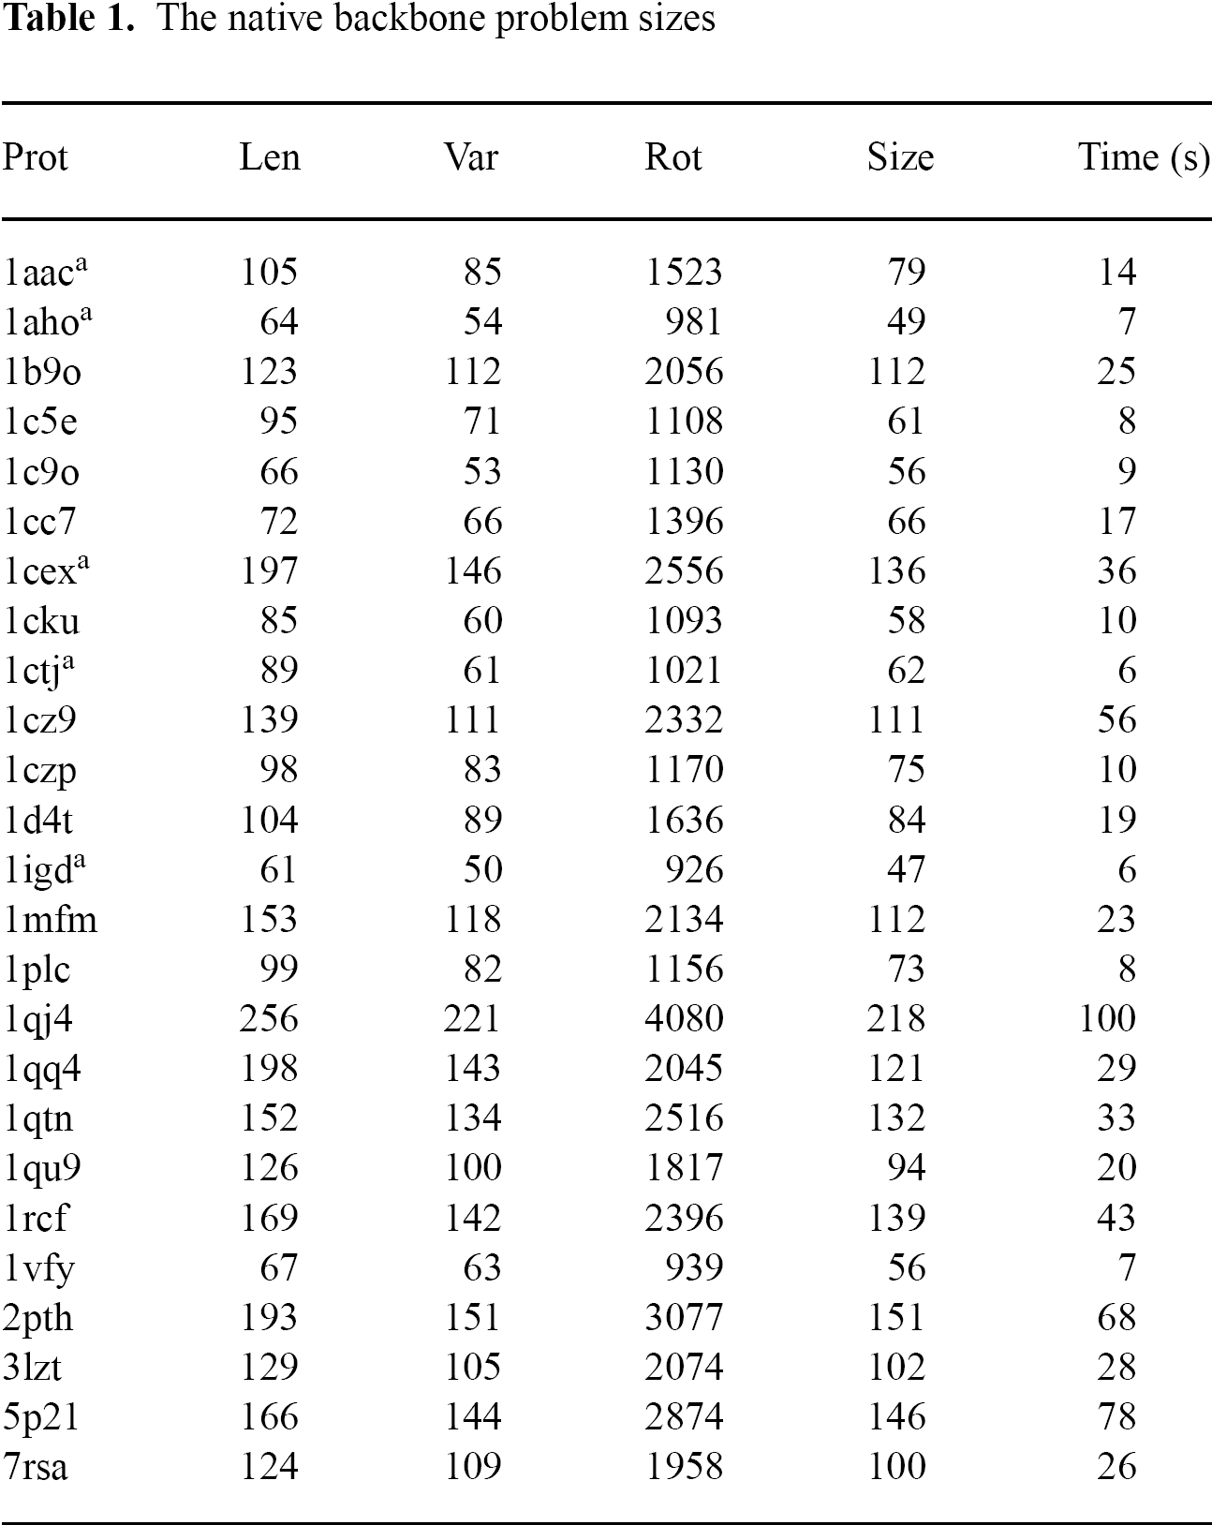
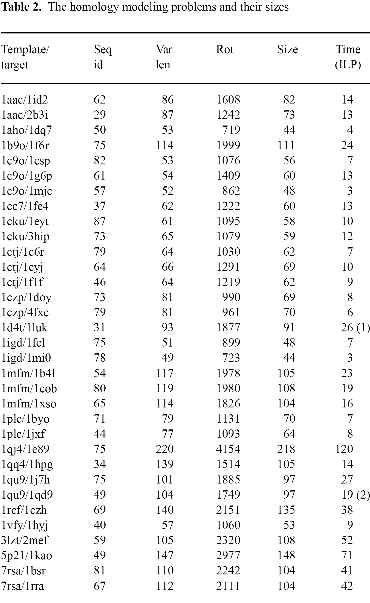
Dataset

Slide 14
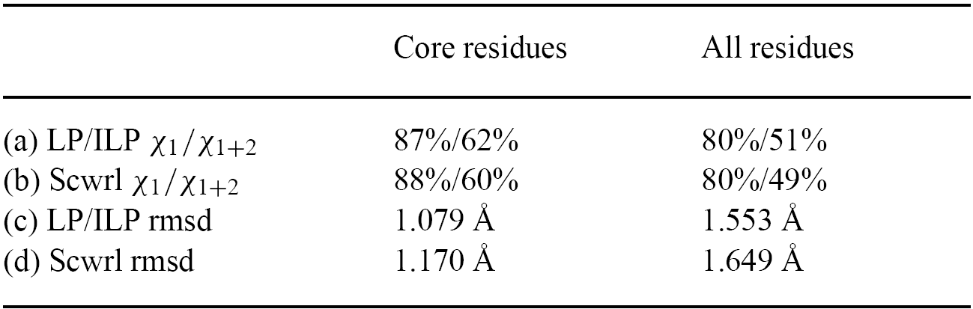
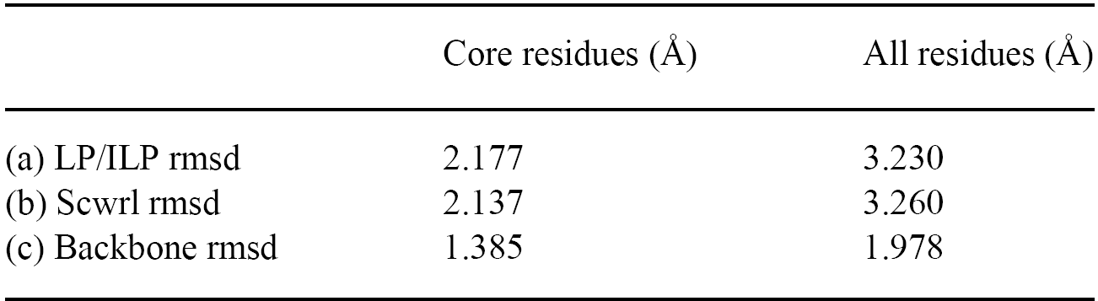
Computational Results

